Slide 1
Programming Arduino and Nano 33 BLE

Slide 2
Contents
Programming Arduino and Nano 33 BLE

Slide 3
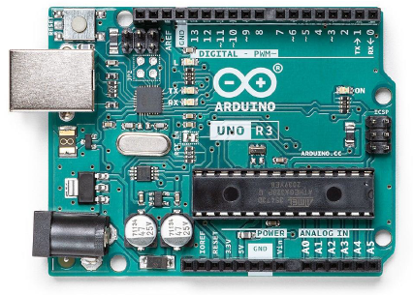
aRDUINO
Arduino’s purpose is to control things by interfacing with sensors and actuators
No keyboard, mouse and screen
Can be attached via “shields”
No operating system, limited memory
A single program enjoys 100% of CPU time
Physical Arduino boards
Uno
Nano
Leonardo
Mega
Pro Mini
Arduino IDE
Installed on a PC (Windows/Mac/Linux)
To develop, install and debug programs on Arduino boards
Communicates with Arduino board over USB
Third party Arduino compatible boards
STM32
Nucleo / Discovery / Feather,
Adafruit
SparkFun

Slide 4
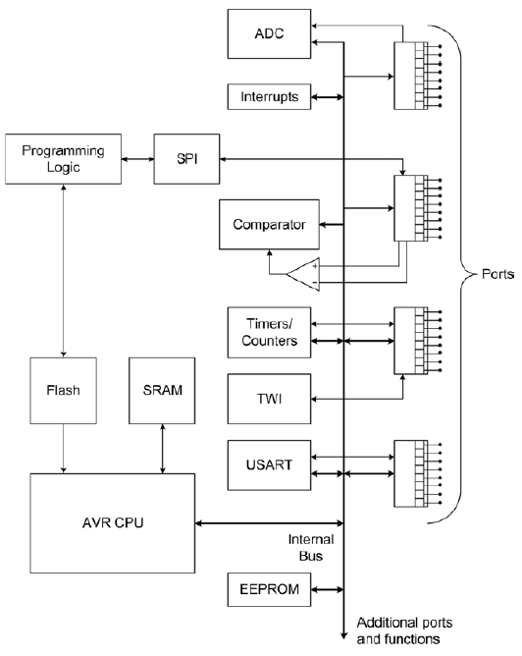
aRDUINO
A generic AVR microcontroller block diagram
CPU
Internal Memory
Flash (stores program code)
SRAM (holds data and variable during execution)
EEPROM (holds persistent data generated by program)
Peripherals
A/D converter (ADC)
Timers
UART
SPI
DMA
GPIO
TWI
Comparator
RTC
WDT
RNG

Slide 5
aRDUINO
Interfacing with Arduino
Temperature sensor
Pressure sensor
Switches
Variable resistor
Range finder
PIR (person
in room) sensor
Relay
Motor control
LED
16x2 display
Graphic display
Bluetooth shield
WiFi
shield
Ethernet shield
Arduino Libraries:
https://www.arduinolibraries.info/libraries

Slide 6
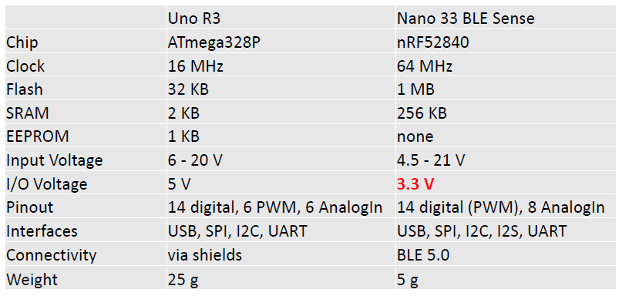
aRDUINO
Uno vs Nano 33 BLE Sense

Slide 7
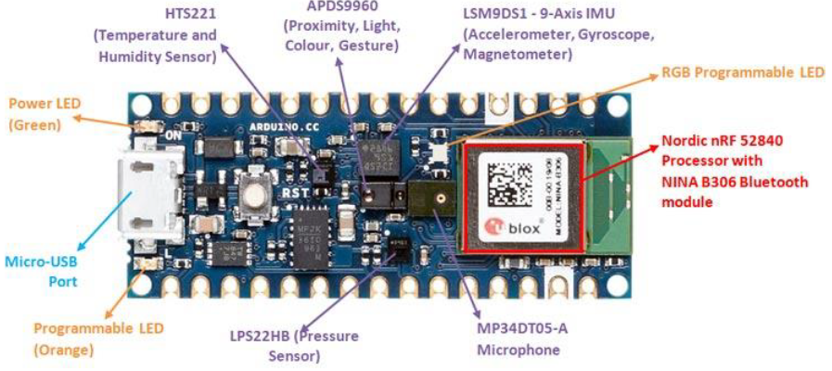
aRDUINO
Features of Nano 33 Sense
8 Analog Input Pins can provide 12-bit ADC at about 30 kHz
Integrated sensors (IMU, Mic, Light, Pressure, Temperature, Humidity)
All digital pins can trigger interrupts
Only supports 3.3V I/Os and is NOT 5V tolerant so please make sure you are not directly connecting 5V signals to this board or it will be damaged

Slide 8
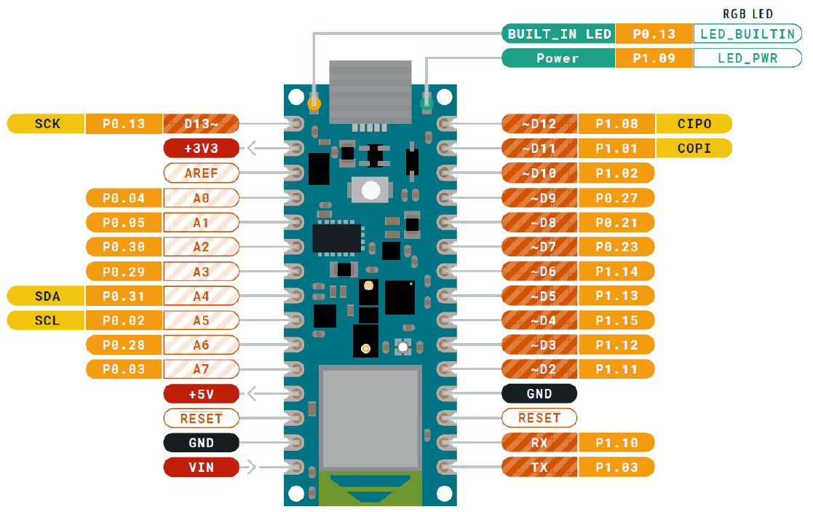
Nano 33 Sense
Nano 33 Sense

Slide 9
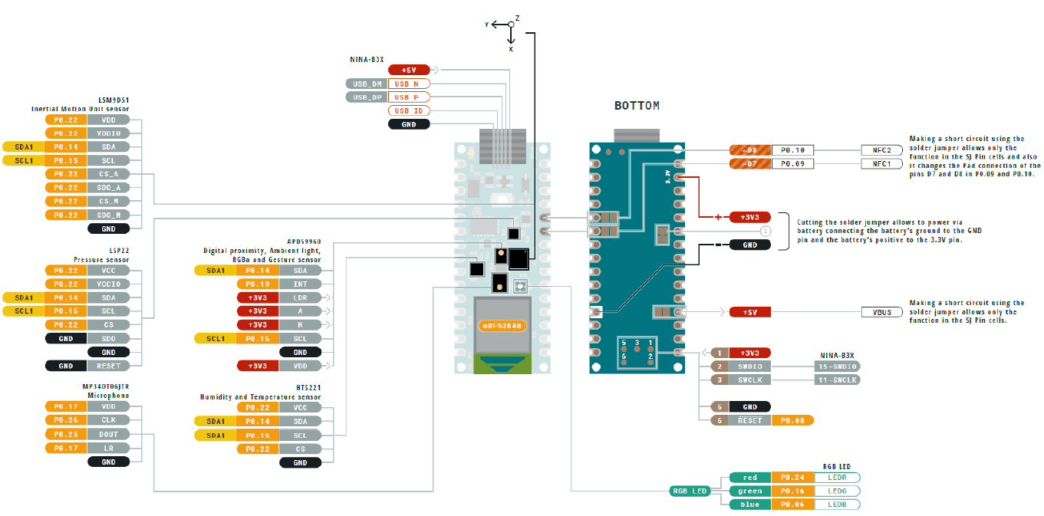
Nano 33 Sense
Nano 33 Sense

Slide 10
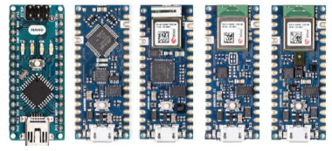
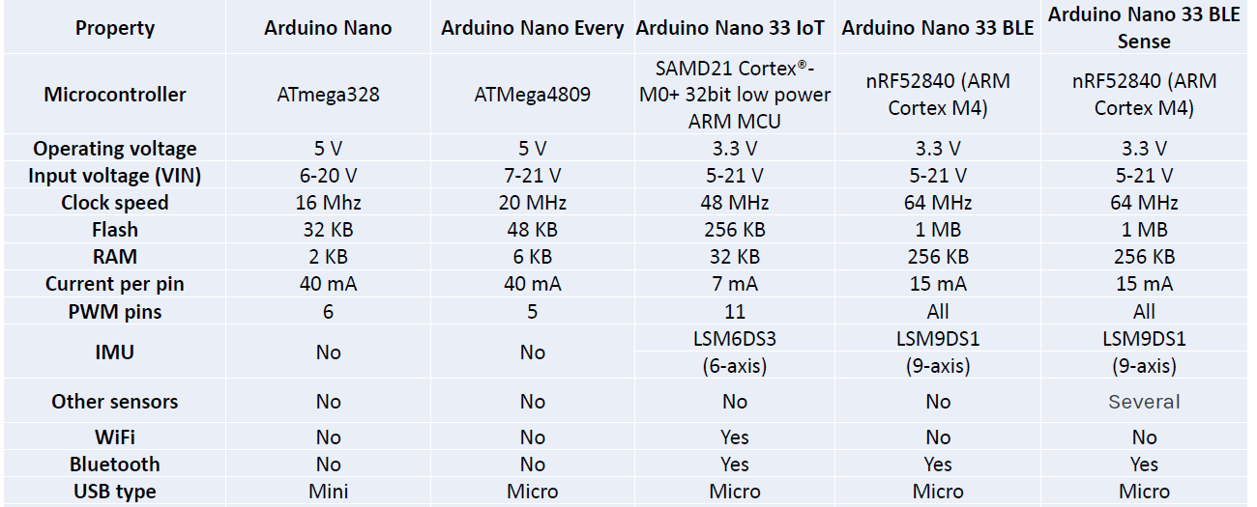
Nano 33 Sense
Arduino Nano comparisons

Slide 11
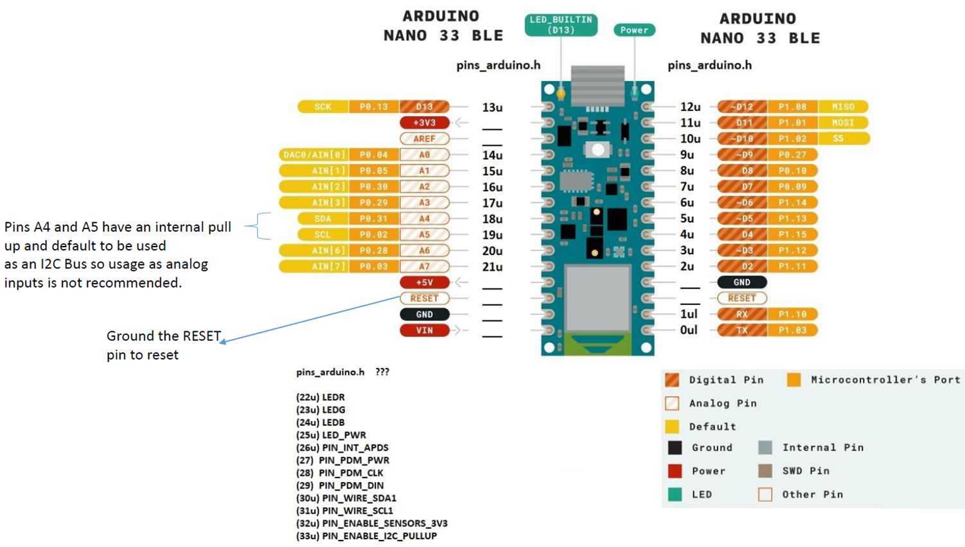
Nano 33 Sense
Pinout

Slide 12
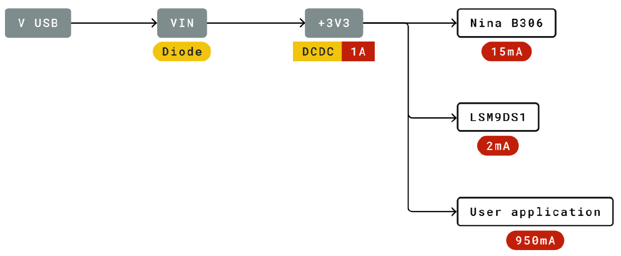
Nano 33 Sense
Nano 33 BLE Power Tree

Slide 13
Nano 33 Sense
nRF52840
Arduino Nano BLE (and BLE Sense) is based on the nRF52840 microprocessor made by Nordic
nRF52840 has the ARM Cortex M4 processor with single precision floating point unit (FPU)
The nRF52840 contains 1 MB of flash and 256 kB of RAM that can be used for code and data storage
The flash can be read an unlimited number of times by the CPU, but it has restrictions on the number of times it can be written and erased (minimum 10,000 times) and also on how it can be written
The flash is divided into 256 pages of 4 kB each that can be accessed by the CPU via both the ICODE and DCODE buses

Slide 14
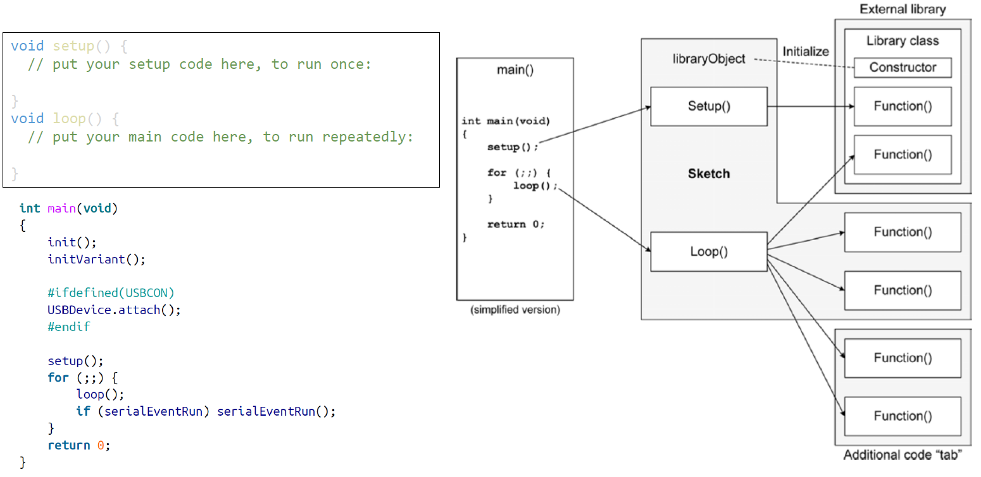
Nano 33 Sense
Arduino Sketch Structure

Slide 15
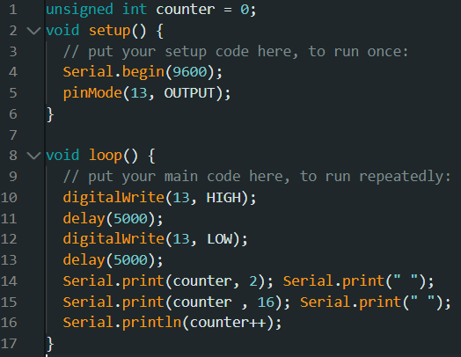
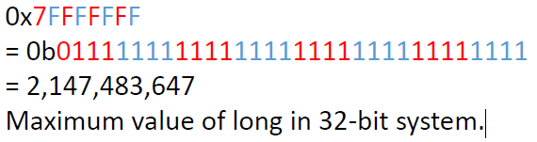
Nano 33 Sense
Arduino Sketch Example

Slide 16
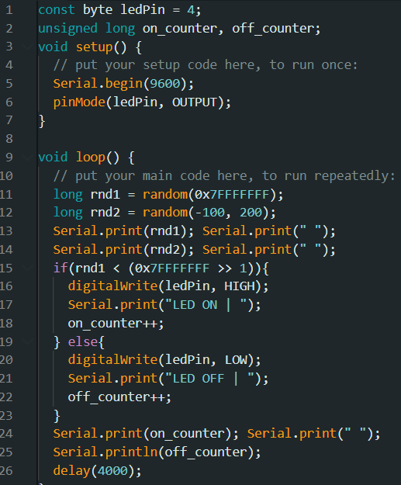
Nano 33 Sense
Arduino Sketch Example

Slide 17
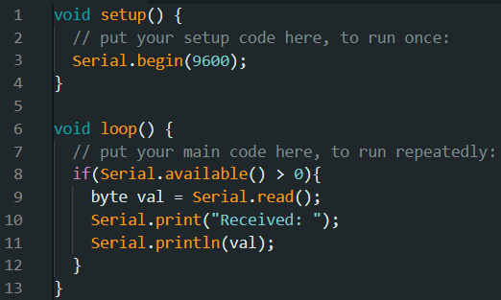
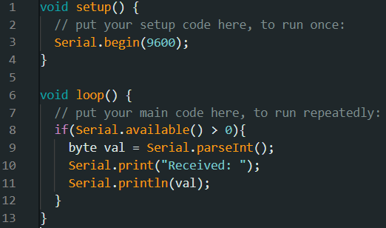
Nano 33 Sense
Read form serial
https://www.arduino.cc/reference/en/

Slide 18
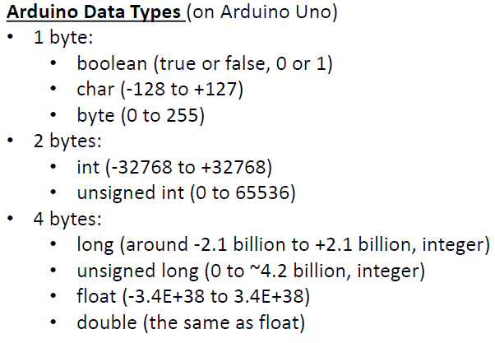
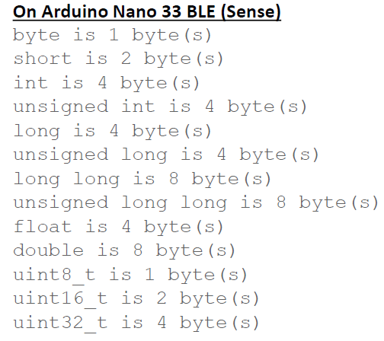
Nano 33 Sense
Length of data type may be different on different CPUs

Slide 19
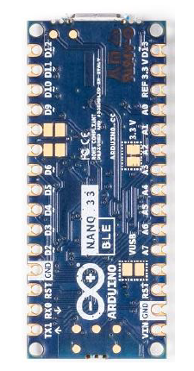
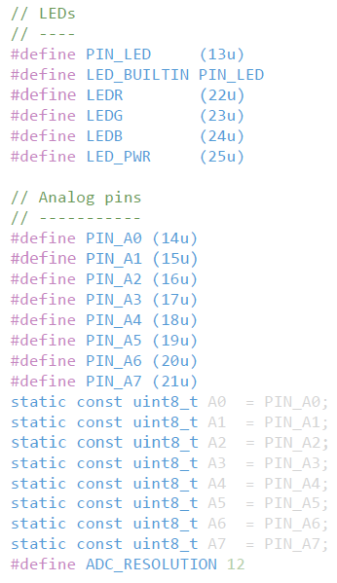
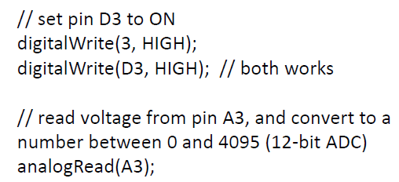
Nano 33 Sense
Arduino Pin Names
Pin name aliases are defined in the pins_arduino.h
As a convention
Digital pins can be referred by the number (e.g., 3) or D+number (e.g. D3)
Analog pins must be referred by A+number , e.g., A3

Slide 20
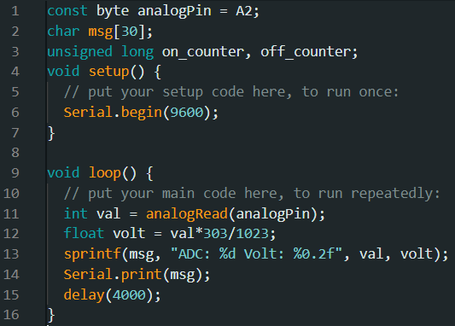
Nano 33 Sense
Arduino Sketch Example
To test, connect a jumper cable to A2, and try connecting the other end to 3.3 V or GND, and observe the output in the Serial Monitor

Slide 21
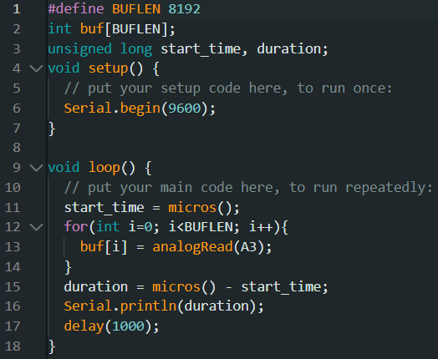
Nano 33 Sense
Arduino Sketch Example

Slide 22
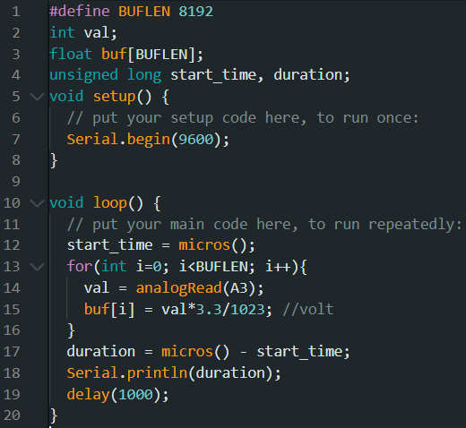
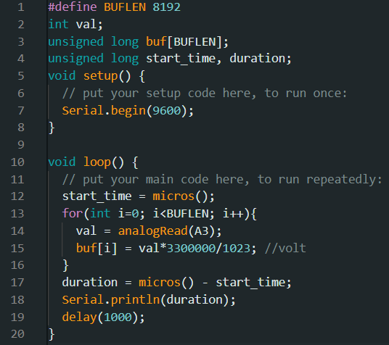
Nano 33 Sense
Integer vs Floating point arithmetic

Slide 23
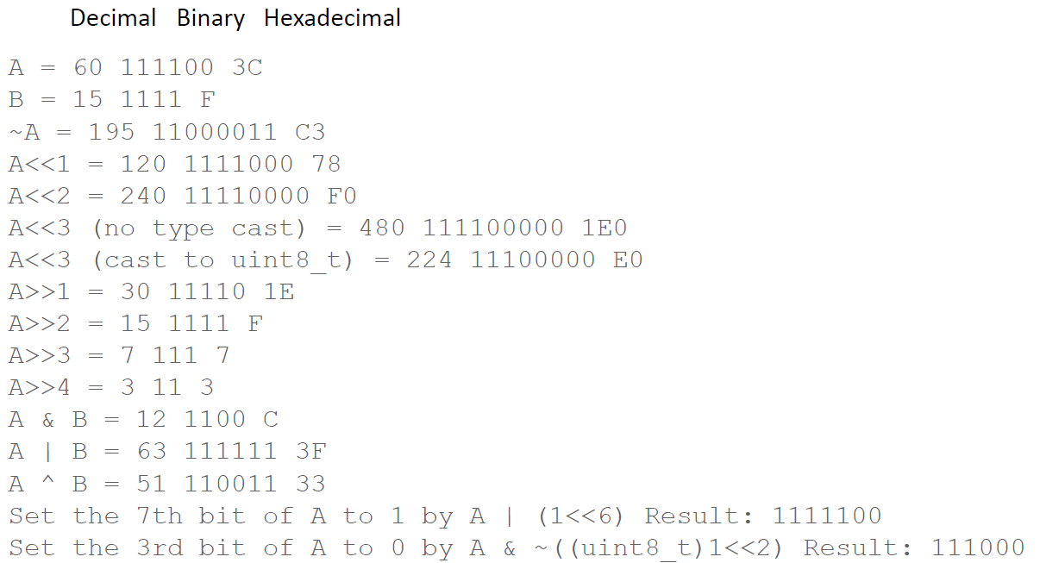
Nano 33 Sense
Bitwise operation

Slide 24
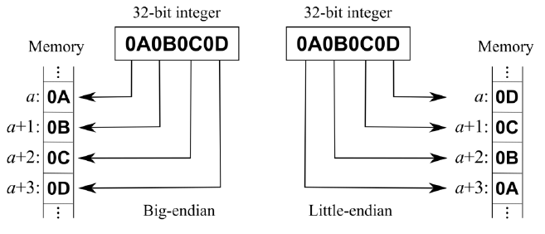
Nano 33 Sense
Endianness and byte addressing
Beware of the endianness when you need to manipulate or transmit data by bytes, or when memory contents are transmitted between computers with different endianness
Casting an uint32_t integer to uint8_t takes the low 8-bit of the integer

Slide 25
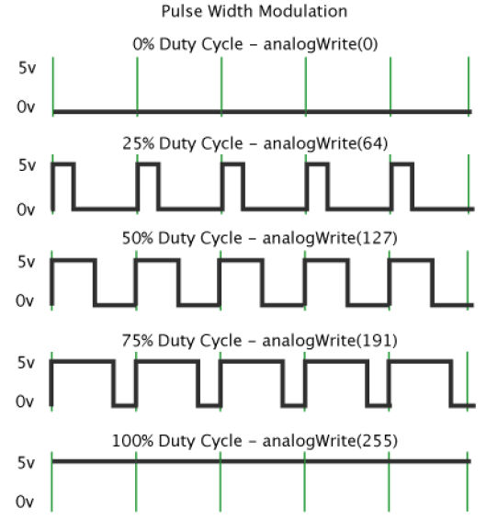
Nano 33 Sense
Pulse Width Modulation (PWM)
A technique for getting analog results with digital means
Digital control is used to create a square wave, a signal switched between ON and OFF
The simulated analog voltage is the portion of the time the signal spends ON versus the time that the signal spends OFF
https://docs.arduino.cc/learn/microcontrollers/analog output

Slide 26
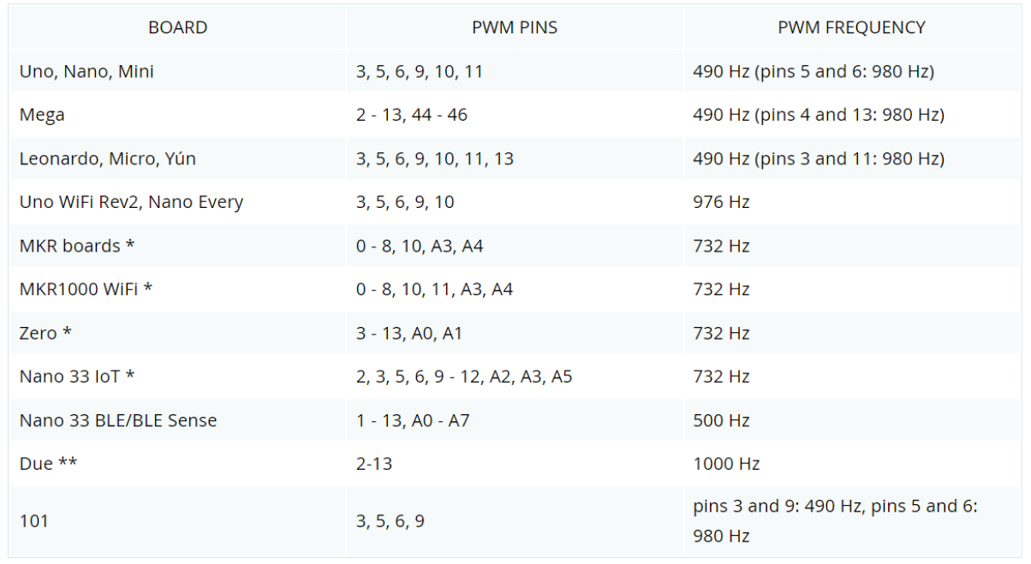
Nano 33 Sense
PWM Frequency and Pins

Slide 27
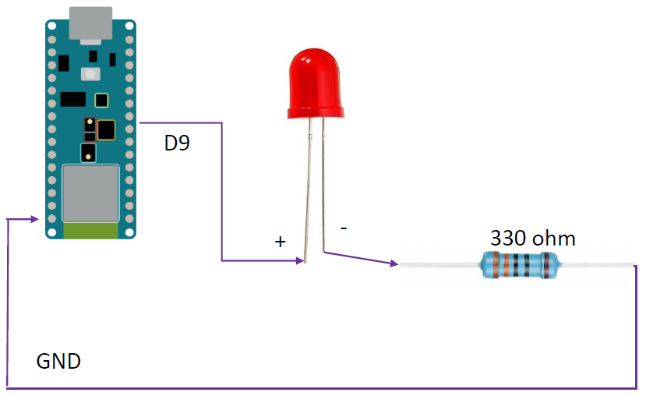
Nano 33 Sense
PWM example (use PWM to fade LED)
Examples--> 01. Basics --> Fade

Slide 28
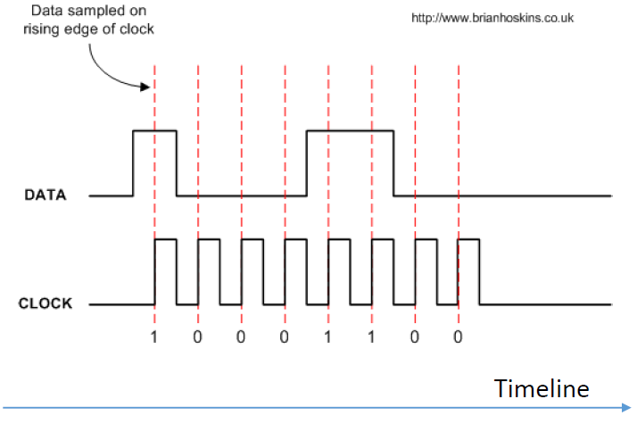
Nano 33 Sense
Two-wire serial communication toy example
Serial interface is common in device communications
Send / Receive data one bit at a time
Need a clock signal to synchronize timing between sending and receiving ends
Sender does this to send a byte:
Set the data pin to the first bit (MSB) of the byte to be sent
Wait for the signal to be stable
Pulse the clock pin
Repeat step 1 for the next bit until all 8 bits are sent

Slide 29
Nano 33 Sense
Two-wire serial communication toy example
Serial interface is common in device communications
Send / Receive data one bit at a time
Need a clock signal to synchronize timing between sending and receiving ends
Sender does this to send a byte:
Set the data pin to the first bit (MSB) of the byte to be sent
Wait for the signal to be stable
Pulse the clock pin
Repeat step 1 for the next bit until all 8 bits are sent

Slide 30
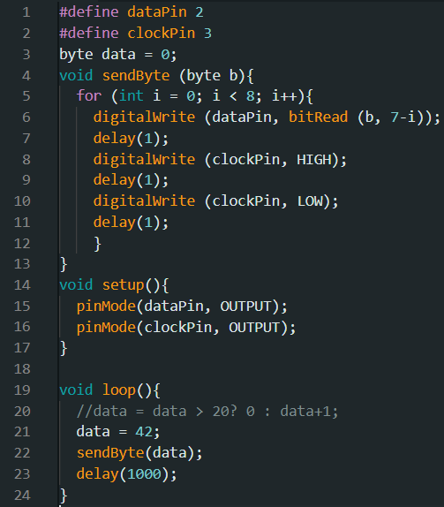
Nano 33 Sense
Two-wire serial send (tx) example

Slide 31
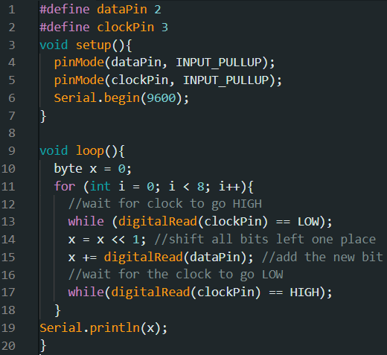
Nano 33 Sense
Two-wire serial receive (rx) example

Slide 32
Nano 33 Sense
Two-wire serial communication
Upload the Tx code to the sender board, upload Rx code to the receiver board
Make sure two boards have the same I/O voltage
e.g., don’t connect Uno (5v) with Nano (3.3v)
Connect the sender and receiver
sender’s dataPin --> receiver’s dataPin
sender’s clockPin --> receiver’s clockPin
Open the Serial Monitor on the receiver end to see data received
CAUTION
Don’t upload the sender code to both boards and connect them
Can damage boards when two digital output pins connect

Slide 33
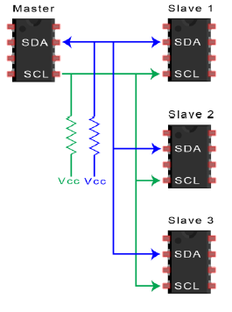
Nano 33 Sense
I2C Interface
I2C is a serial communication protocol, commonly used for connecting MCU and sensors
It is a “bus”, meaning multiple devices can use the same two wires (one for timing, one for data)
In other words, the MCU can use only two wires to communicate with multiple (up to 127) devices (i.e., sensors)

Slide 34
Nano 33 Sense
I2C Interface
The device that provides the clock signal is the “master”, all others are “slaves”
Typically, the MCU is the master, sensor units are slaves
Each slave connected on the bus should have a unique address, which is a number between 1 and 127
The value 0 is the broadcast address
The master identifies the slave by the slave’s address
For a sensor unit, its I2C address is typically hardcoded, and is explained in the datasheet

Slide 35
Nano 33 Sense
I2C hardware
I2C uses two wires (thus, also called two wire interface, or TWI): Serial Clock (SCL) line and Serial Data (SDA) line
When no data is transmitted, SCL and SDA lines are in a tri state or free state, i.e., neither HIGH nor LOW, a floating value
When there is data to be transmitted, the sender (master or slave) takes the SDA line out of tri state and sends data as logic highs and lows in time with the clock signal
When transmission is complete, the clock signal can stop, and the SDA line is returned to tri state
Usually the slave only sends data upon the master’s request, so the clock signal is guaranteed available

Slide 36
Nano 33 Sense
I2C Library
On Arduino, the Wire library provides functions for I2C communication
https://www.arduino.cc/reference/en/language/functions/communication/wire/begin
https://www.arduino.cc/reference/en/language/functions/communication/wire/end
https://www.arduino.cc/reference/en/language/functions/communication/wire/requestfrom
https://www.arduino.cc/reference/en/language/functions/communication/wire/begintransmission
https://www.arduino.cc/reference/en/language/functions/communication/wire/endtransmission
https://www.arduino.cc/reference/en/language/functions/communication/wire/write
https://www.arduino.cc/reference/en/language/functions/communication/wire/available
https://www.arduino.cc/reference/en/language/functions/communication/wire/read
https://www.arduino.cc/reference/en/language/functions/communication/wire/setclock
https://www.arduino.cc/reference/en/language/functions/communication/wire/onreceive
https://www.arduino.cc/reference/en/language/functions/communication/wire/onrequest
https://www.arduino.cc/reference/en/language/functions/communication/wire/setwiretimeout
https://www.arduino.cc/reference/en/language/functions/communication/wire/clearwiretimeoutflag
https://www.arduino.cc/reference/en/language/functions/communication/wire/getwiretimeoutflag

Slide 37
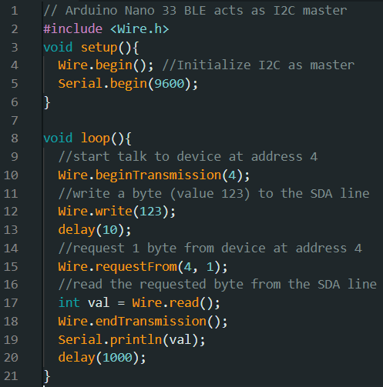
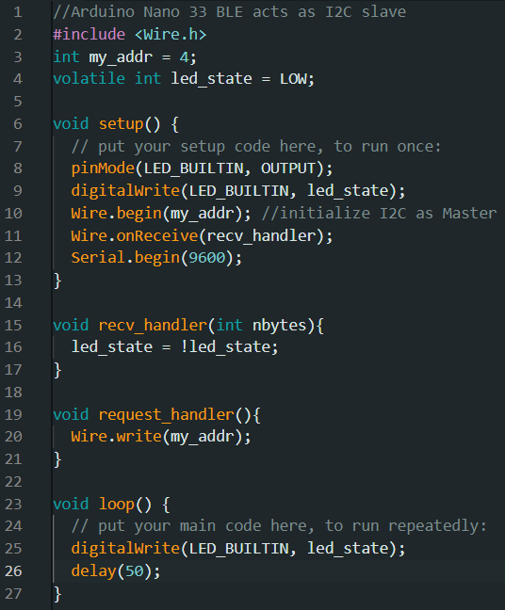
Nano 33 Sense
I2C experiments
Connect two Arduino Nano 33 BLE boards via I2C
One acts as master and the other acts as slave

Slide 38
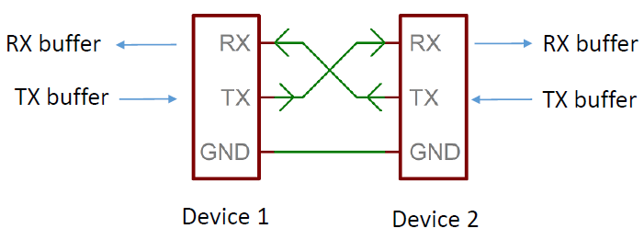
Nano 33 Sense
UART Protocol
UART (Universal asynchronous receiver transmitter) is
A device to device communication protocol
A block of circuitry responsible for implementing serial communication (hardware UART)
https://www.analog.com/en/analog-dialogue/articles/uart-a-hardware-communication-protocol.html
https://learn.sparkfun.com/tutorials/serial-communication/rules-of-serial

Slide 39
Nano 33 Sense
UART Protocol
The interface can be bit banged, i.e., directly controlled by the processor, called Software UART
Processor intensive, not preferred but does the job when hardware UART is not available
Baud rate must be set the same on both ends of the communication channel
Most typical Baud Rates: 9600 , 19200, 38400, 57600, 115200 , 230400, 460800, 921600, 1000000, 1500000

Slide 40
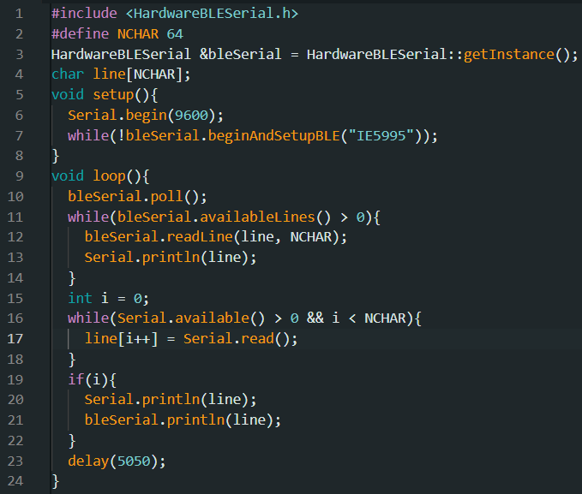
Nano 33 Sense
BLESerial on Nano 33 BLE

Slide 41
Nano 33 Sense
BLESerial on Nano 33 BLE
Install the HardwareBLESerial library
Upload the code to Nano 33 BLE
Modify “IE5995” to something else before uploading, to prevent conflicts
Download the phone app “Bluefruit Connect”
Via App Store or Google Play
Connect to the device via Bluefruit Connect
Open UART in Bluefruit Connect
Open Serial Monitor of the PC that’s connected to Nano 33 BLE
You can exchange text messages between the Serial Monitor on PC and the UART console in Bluefruit Connect on the cellphone

Slide 42
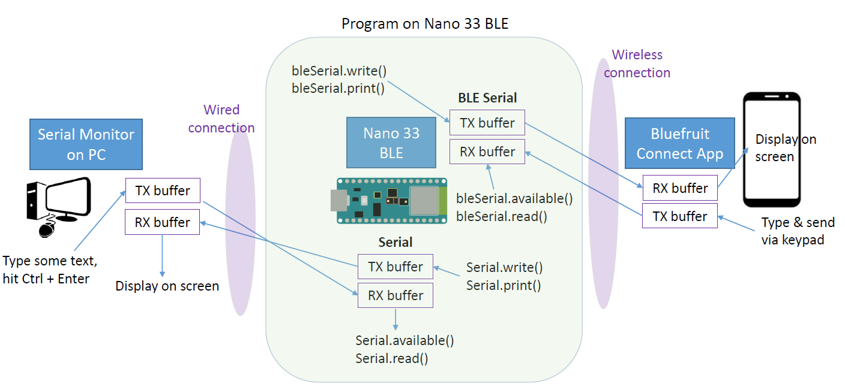
Nano 33 Sense
BLESerial on Nano 33 BLE

Slide 43
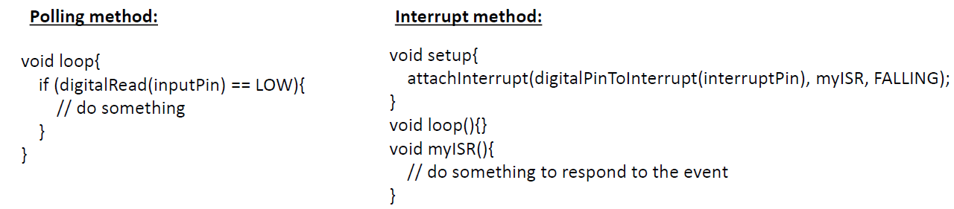
Nano 33 Sense
Interrupts
Interrupts allow microcontrollers to respond to events without having to repeatedly poll to see if the event has occurred
Interrupts can be triggered by a Pin or by a Timer

Slide 44
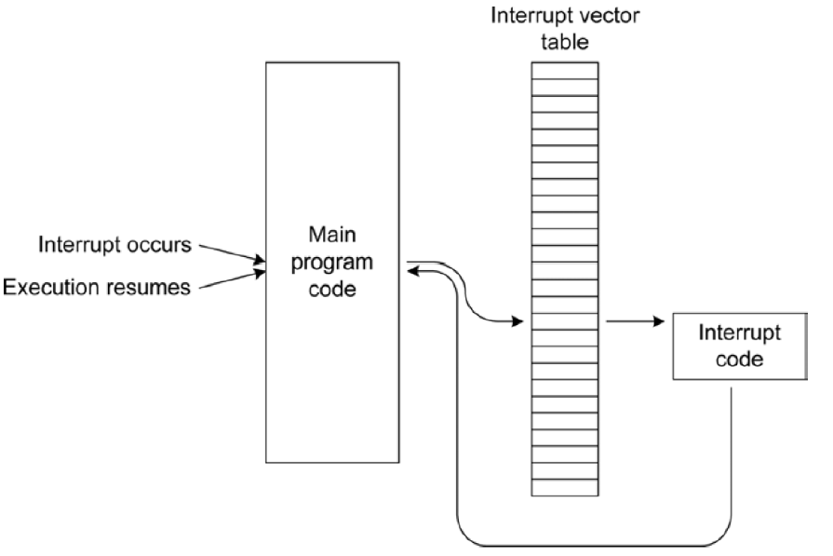
Nano 33 Sense
Interrupts
Interrupt Handling Process

Slide 45
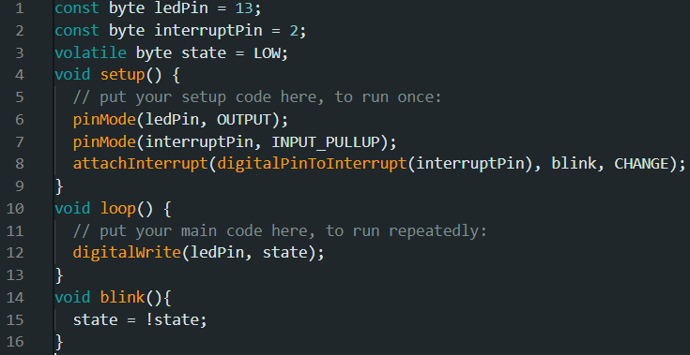
Nano 33 Sense
Interrupts
Example

Slide 46
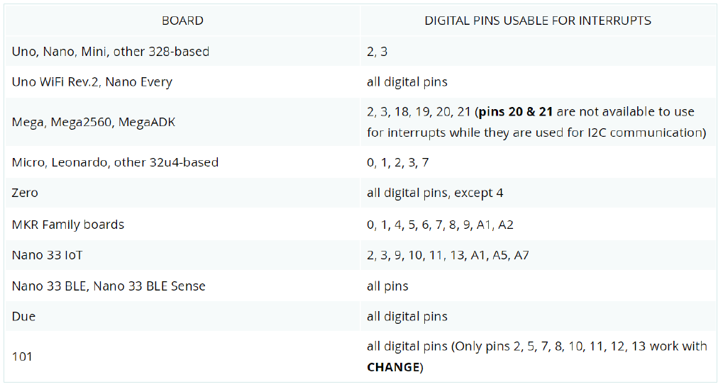
Nano 33 Sense
Interrupts
Pins available for interrupts

Slide 47
Nano 33 Sense
Arduino code optimization for speed
Avoid using float
Floating point arithmetic is slow on hardware that does not support it
Use long instead, which can retain more digits of precision, and faster
Lookup rather than calculate
Use const byte instead of int for small constants such as Pin names
Move looping code into the setup function
The loop() function checks for Serial communication which takes time
Speeding up Digital IO
Directly manipulate the pin bit in the port register
Speeding up Analog Inputs
Reducing the prescaler of the Timer that triggers ADC conversions

Slide 48
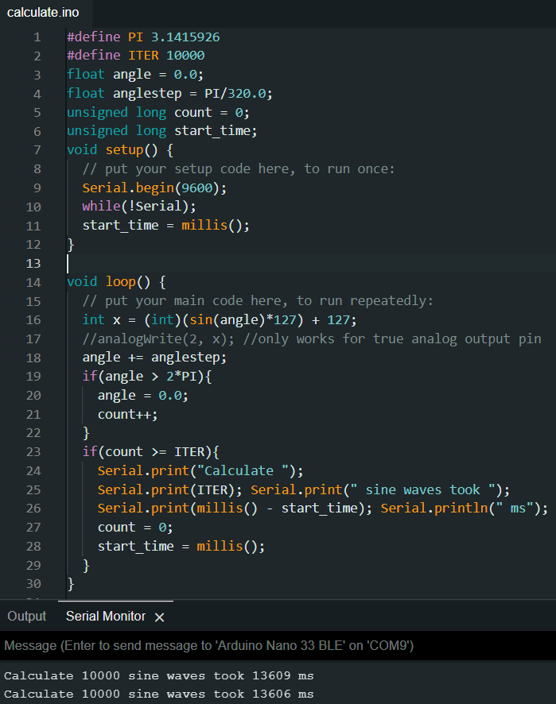
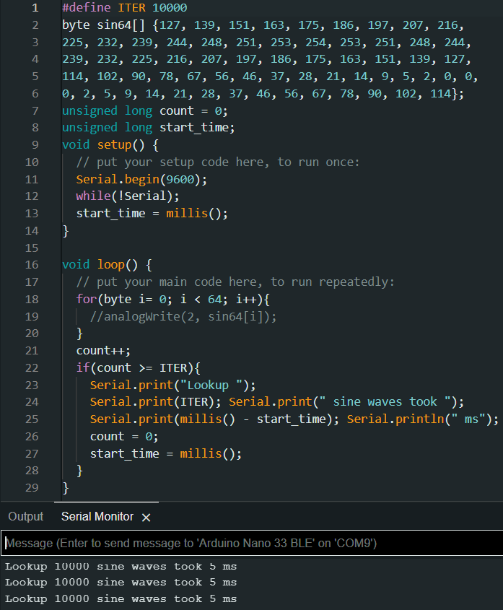
Nano 33 Sense
Arduino code optimization for speed

Slide 49
Nano 33 Sense
Minimize power usage
If the product is battery operated, reducing power usage is important
Ways to reduce power consumption
Put the microcontroller in sleep when it is not doing anything
Turn off (disable) unused peripherals
Use lowest clock frequency sufficient
Use lower input voltage if allowable
Provide power to sensor only when taking a reading

Slide 50
Nano 33 Sense
Minimize RAM usage
Reduce the amount of memory used by data and variables
Choose data type based on need, especially for large arrays
Int is at least 2 byte, values range in [ 32,768, 32767]
If the value range of [0, 255] suffices, use byte , which is 1 byte
Store string constants in Flash Memory
Serial.println(“Some message to print”); // Stored both in flash memory and in RAM
Serial.println(F (“Some message to print”)); // Fetched from flash memory, no RAM use
Use PROGMEM directive to store constant arrays in Flash
#include <avr/pgmspace.h>
Use const if the variable value do not change while the sketch is running
“const int v = 5000;” uses less memory than “int v = 5000;” and runs faster when v is used in computation
Bypass the bootloader
The Nano 33 BLE bootloader takes 35 KB of Flash Memory
There is a way to program the chip without using a bootloader, thus saving RAM and reducing start-up time
Length of variable names does not help save memory

Slide 51
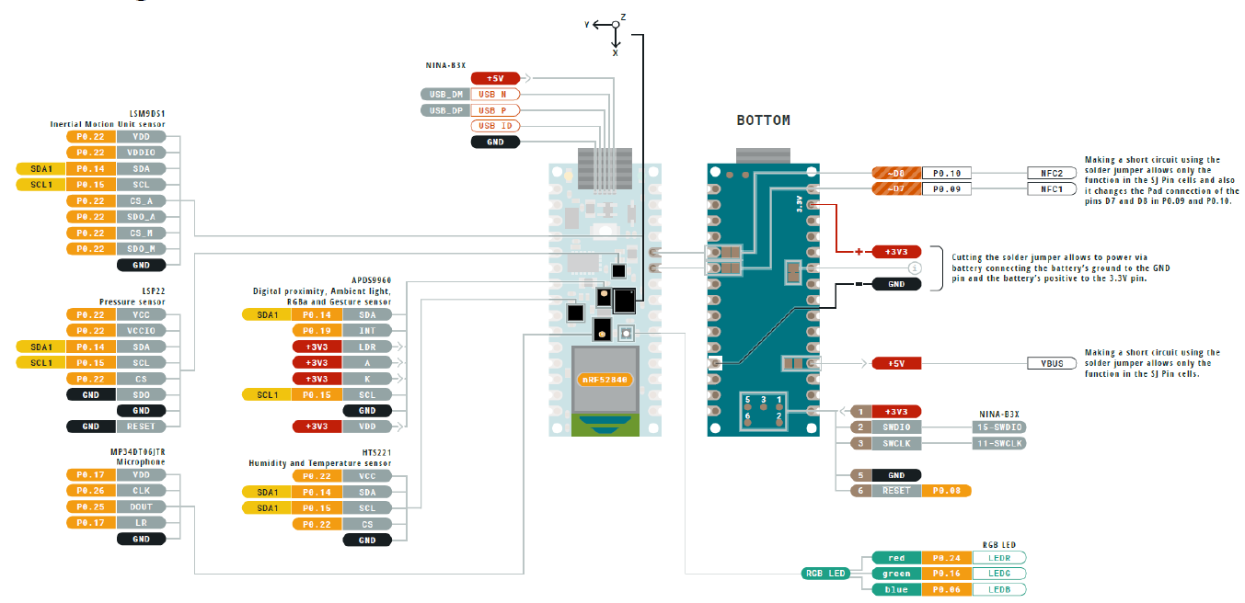
Nano 33 Sense
Integrated sensors on Nano 33 BLE Sense

Slide 52
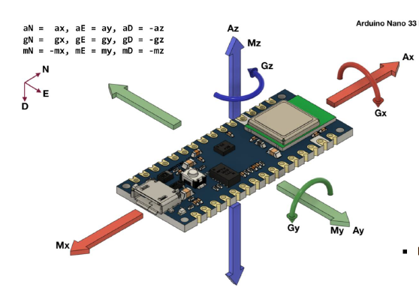
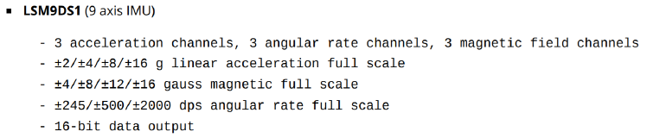
Nano 33 Sense
Integrated sensors on Nano 33 BLE Sense
LSM9DS1
The LSM9DS1 inertial measurement unit (IMU)
accelerometer
gyroscope
magnetometer
Useful for detecting orientation, motion or vibrations
Datasheet: https://content.arduino.cc/assets/Nano_BLE_Sense_lsm9ds1.pdf
Library “Arduino_LSM9DS1”

Slide 53
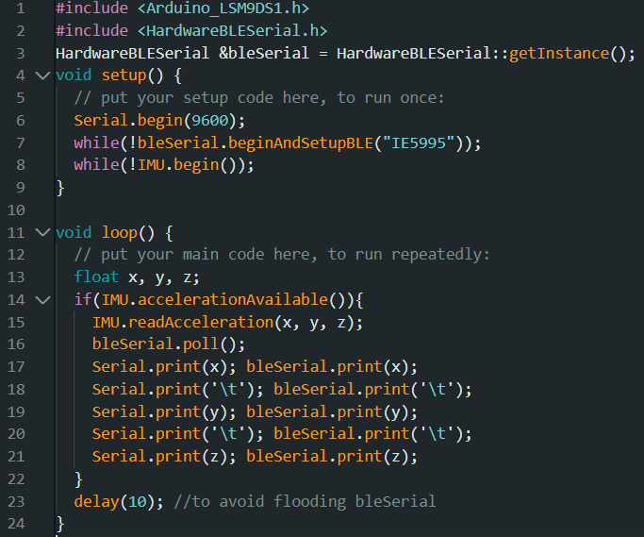
Nano 33 Sense
Integrated sensors on Nano 33 BLE Sense
LSM9DS1

Slide 54
Nano 33 Sense
Interact with sensors on the I2C bus
There are ready made libraries to read sensor data from the integrated sensors on the BLE Sense board
For the sake of learning, let us implement our own “device driver” to obtain sensor data
We will start with the barometric pressure sensor LPS22HB

Slide 55
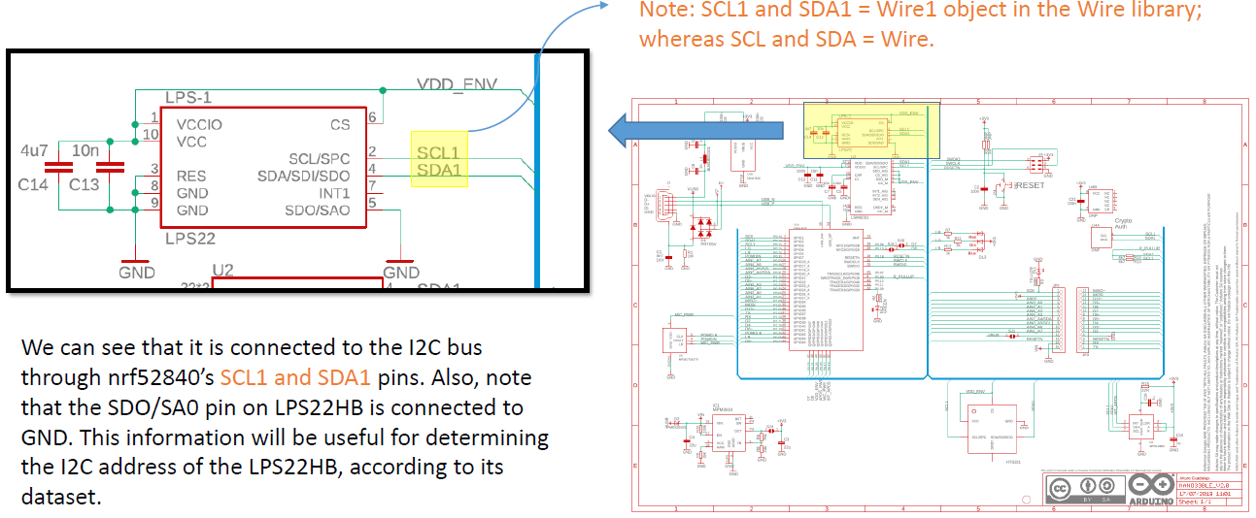
Nano 33 Sense
Interact with sensors on the I2C bus
Write your own device driver for LPS22HB
First, find out how LPS22HB is physically connected to the nrf52840 MCU on the BLE Sense Rev2 board

Slide 56

Nano 33 Sense
Interact with sensors on the I2C bus
Write your own device driver for LPS22HB
Next, find the datasheet of LPS22HB and go to the I2C operation section

Slide 57


Nano 33 Sense
Interact with sensors on the I2C bus
Write your own device driver for LPS22HB
When we need the sensor to acquire a new reading, we need to set the least significant bit (bit 0) of the CTRL_REG2 register

Slide 58

Nano 33 Sense
Interact with sensors on the I2C bus
Write your own device driver for LPS22HB
The pressure data is 24 bit; thus we need to read the three 8 bit registers (at addresses 0x28, 0x29 and 0x2A)
If IF_ADD_INC bit is set in CTRL_REG2, then register address will be automatically incremented in repeated read of multi byte data

Slide 59

Nano 33 Sense
Interact with sensors on the I2C bus
Write your own device driver for LPS22HB
The temperature is 16 bit value, contained in two registers

Slide 60

Nano 33 Sense
Interact with sensors on the I2C bus
Write your own device driver for LPS22HB
Trigger a conversion

Slide 61

Nano 33 Sense
Interact with sensors on the I2C bus
Write your own device driver for LPS22HB
Check if data is ready, before reading

Slide 62

Nano 33 Sense
Interact with sensors on the I2C bus
Write your own device driver for LPS22HB
Read data

Slide 63

Nano 33 Sense
Interact with sensors on the I2C bus
Write your own device driver for LPS22HB
Read data

Slide 64


Nano 33 Sense
Interact with sensors on the I2C bus
Write your own device driver for LPS22HB
Complete code:

Slide 65
20ms
5ms

